Slide 1
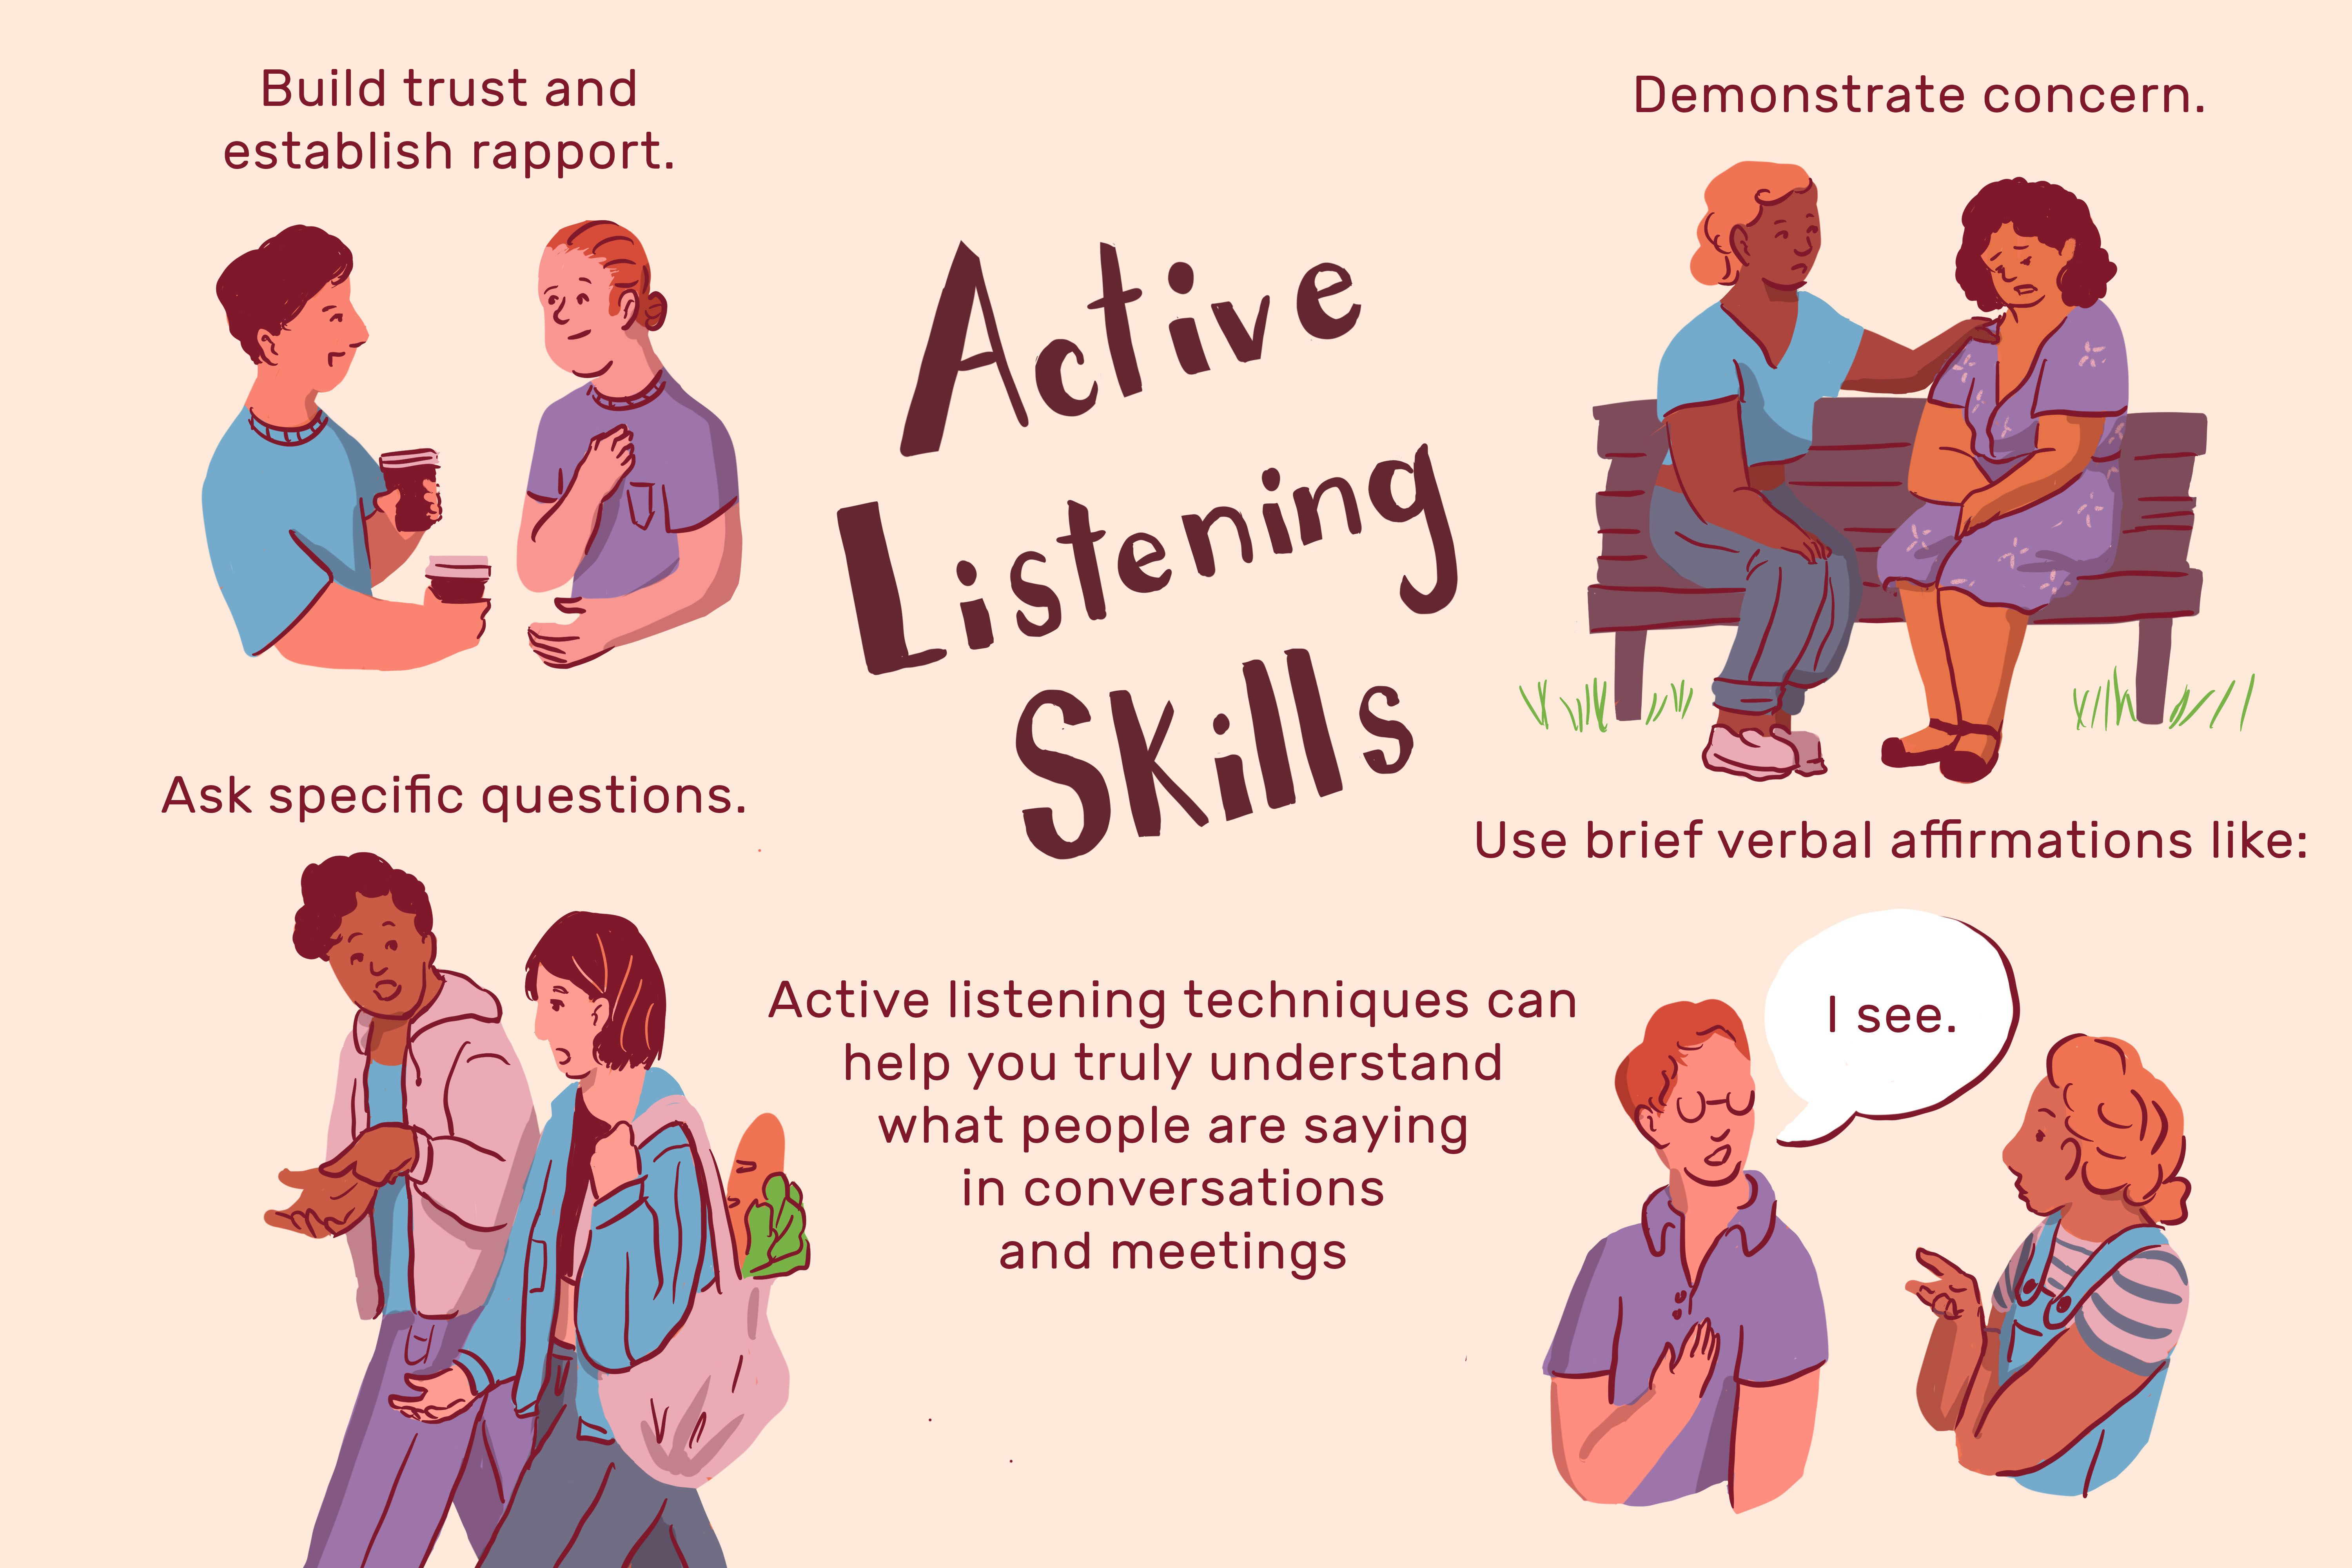
Active Listening
Officer Cindy Boyle –Western Mass CIT-TTAC, Law Enforcement Coordinator
Monica Bellucci, M.Ed, LMHC – Western Mass CIT-TTAC, Clinical Coordinator

Slide 2
ACTIVE LISTENING
WHAT MENTAL HEALTH DISORDERS/CRISIS SITUATIONS RESPONDTO ACTIVE LISTENING?
ALL OF THEM!
WHAT IS AT THE “CORE” OF ALL ACTIVE LISTENING?
ATTACHMENT/CONNECTION!

Slide 3
ACTIVE LISTENING
“Being fully engaged while another person is talking to you. Listening with the intent to understand, rather than listening to respond.”
Listening to how someone may be feeling to understand whole picture
LISTENING WITH ALL OF OUR SENSES!

Slide 5
ACTIVE LISTENING
Introduction
Provide your name
State that you are there to help
Empathy
The ability to share understand and share feeling with another
“I hear you”, “I want to understand”, “what you’re saying makes sense to me”
Listen for emotions, validate emotions, minimize or ignore behaviors during this time.
DO NOT say “I understand you are upset but this is not the way to behave”.

Slide 6
ACTIVE LISTENING
Effective Pauses/planned ignoring
Utilize silence to encourage the individual to fill space and disengage when individual is highly charged (silence is hard, its ok for you to be uncomfortable)
Think about how the person’s brain is functioning at that moment:
Is the frontal lobe offline, can the individual understand your words and what you are asking them to do
Is the person in crisis? Does that person have a diagnosed mental health condition?
Should we slow down even more? Is there a tool we can use to help get their brain back online quicker (ice, sour foods, a drink of water)? Do we need to help them in regulating their breath?

Slide 7
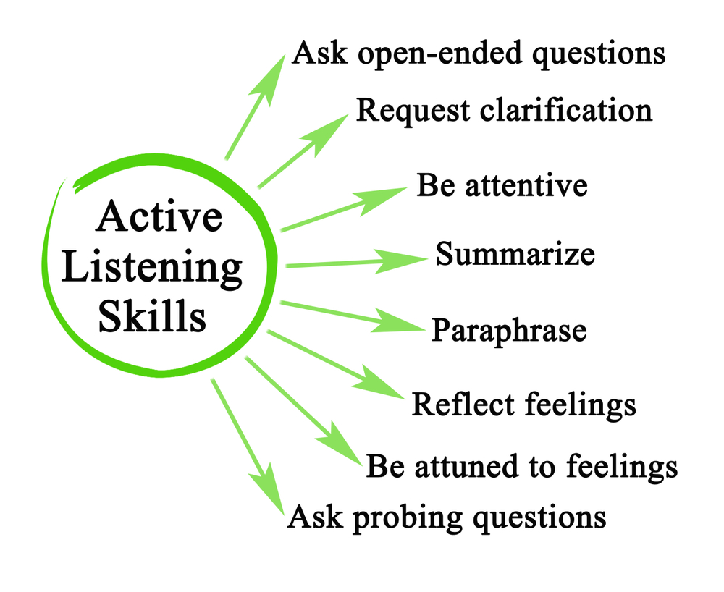
Minimal Encouragers
Utilized sounds, head nods, or short prompts to encourage more dialogue and convey that you are hearing them
Open Ended Questions
Utilize questions that begin with Who, What, Where, When, Why and How. These will typically lead to more dialogue. Try to stay away from questions that require a “yes”, “no” or one word answer.

Slide 8
ACTIVE LISTENING
Using “I” statement
Disclosing how you are feeling during your interaction can help
Begin these statements with “I feel” to avoid becoming accusatory and eliciting a defensive response.
“I am feeling concerned”
“I am feeling a bit confused can you help me understand”
Using “We” statements
Never speak for command staff (telling someone they won’t be arrested or receive a summons to go to court)
Use “we” to get the subject involved in the conversation “I think WE can work this out together”

Slide 10
Final thoughts
Summary
To begin, check that you are in a calm grounded space, slow breath and heartbeat.
Utilize calm tone of voice in volume and inflection and not intimidating body language. Introduce yourself and state that you are there to help.
State the individual’s key points back to them to try and organize the conversation, using active listening skills to clarify your understanding and develop an action plan.
Finally, try to have your statement be shorter than the individual initial dialogue.

